Slide 1
Fintech Hiring trends in the largest banks in the US (A comprehensive analysis of American Express and US Bank)

Slide 2
Insights on hiring patterns for Fintech drawn on Qlik Sense
Inferences drawn for Part 1
Tree Map for Part A, B and C to visualize the key words
Key hiring trends drawn from Part 1 and 2
Top Job Titles in Fintech
Top Fintech Job Categories
Total Occurrences of each keyword in Part 1 in the Job market
Comparison of both banks

Slide 3
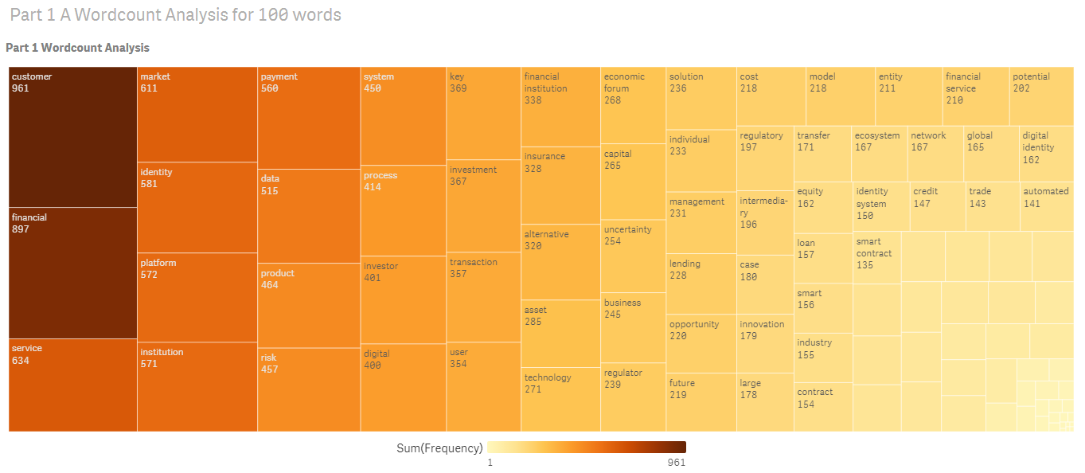
Word count analysis for 100 words

Slide 4
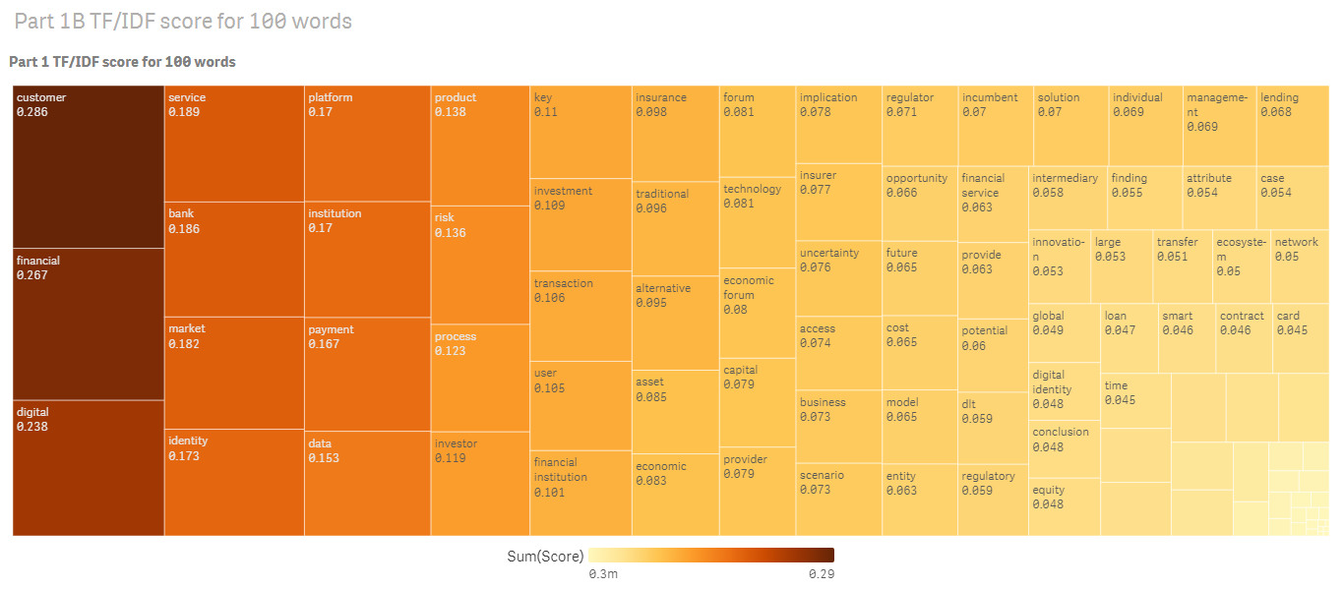
TF/ IDF score for 100 words

Slide 5
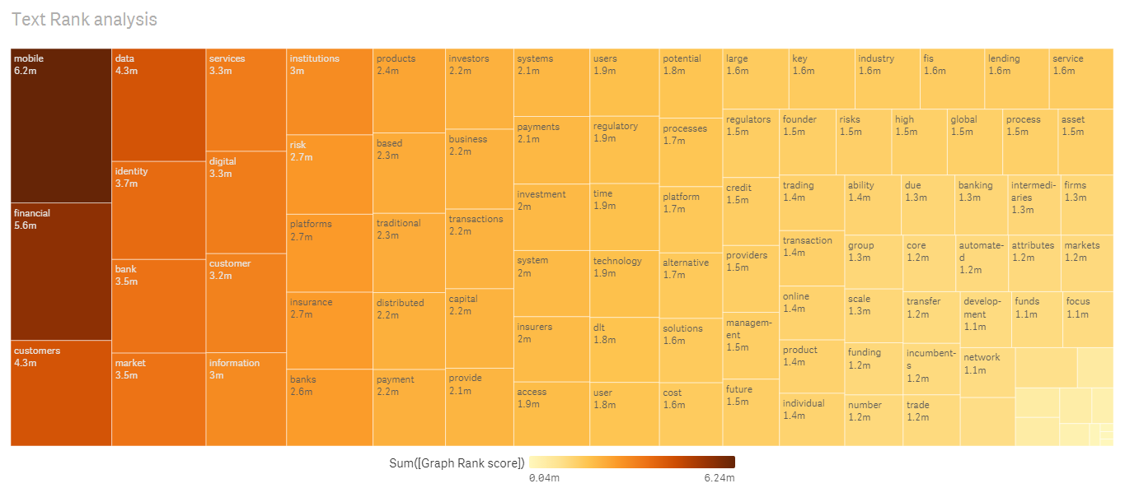
Text Rank analysis for 100 words

Slide 6
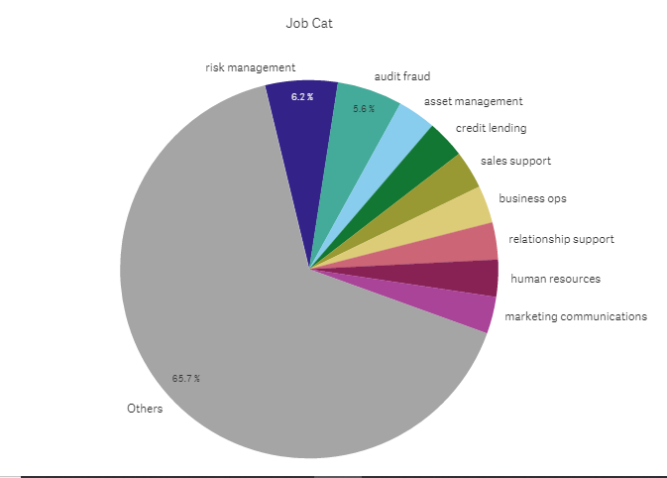
Top Fintech Job Categories

Slide 7
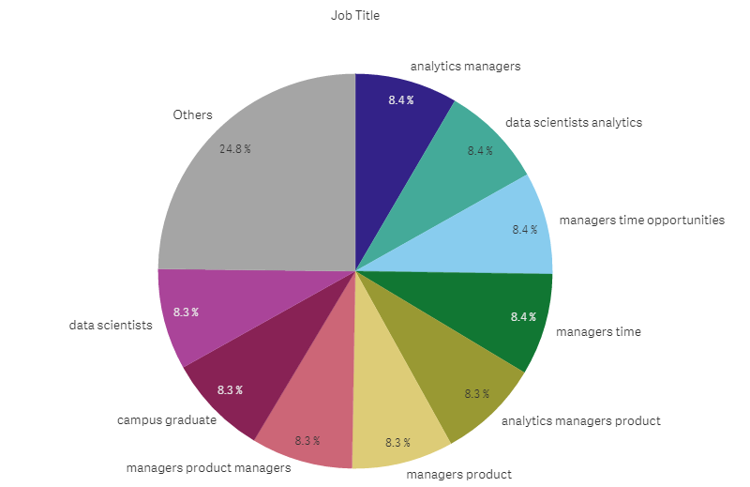
Top Job Titles in Fintech

Slide 8
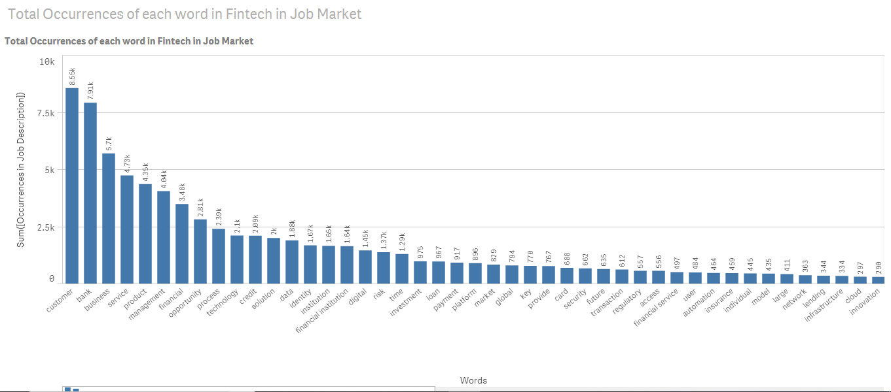
Total Occurrences words in Fintech in Job description

Slide 9
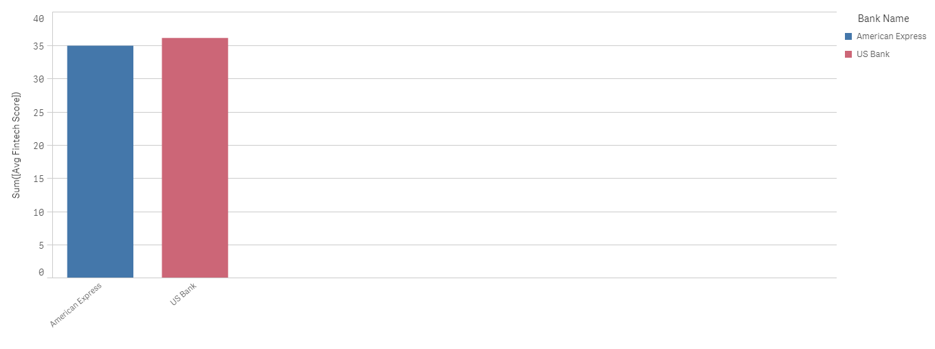
Fintech Comparison of both banks

